Slide 1

Estimation of Ni⁺²
Complexometrically and gravimetrically
ROHAN SINGH
Chemistry Department, University of Delhi
M.Sc. Chemistry, Group-6, S,No-23

Slide 2
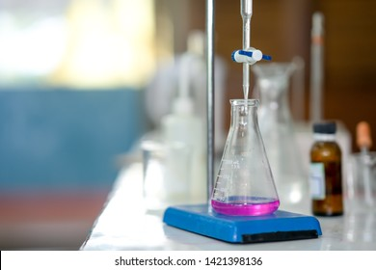
Complexometric Titrations
It is a form of volumetric analysis, based on chemical characteristics of complexes and complex forming reactions to estimate relative proportions of metal ions in a sample
Appearance or disappearance of coloured complexes dictates the end point
EDTA is most widely used as complexone
Forms highly stable 1:1 complexes due to hexadenticity and chelation
Used as disodium salt (Na₂H₂Y), other forms are either acidic, basic or insoluble in water
Ni⁺² ions in a solution can be estimated by direct titration against EDTA, using Murexide (or Bromopyrogallol red) as metal ion indicator
EBT cannot be used as K_{f(Ni-EBT)} > K_{f(Ni-EDTA)} (Ni⁺² is said to block the EBT indicator)
1

Slide 3
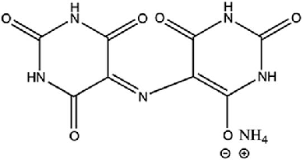
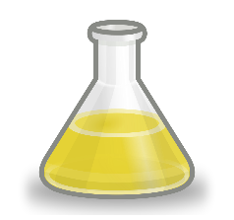
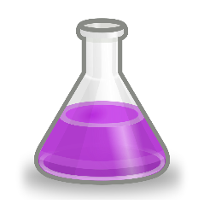
Murexide
It is one of the first metal ion indicators, and is ammonium salt of unstable purpuric acid. It has 4 protons (1 on each imido group) -> H₄D⁻. Only 2 H can be deprotonated by an alkali hydroxide
pH
9
11
H₄D⁻
(red-violet)
H₃D²⁻
(violet)
H₂D³⁻
(blue-violet)
pK_{a} 9.2
pK_{a} 10.5
Characteristics
Chromophores -> Carbonyl (C=O) and Imine (C=N-), Auxochrome -> Imido (batho and hyper chromic shifts)
Tridentate ligand (2 N and 1 O⁻)
Both pH and pM sensitive. Hence, pH needs to be maintained using a buffer
pH range -> 9-11 (violet or blue-violet in free state)
Buffer -> NH₄OH-NH₄Cl (basic ammonical buffer)
Complexes -> Orange (Cu⁺²), Yellow (Co⁺², Ni⁺²), Red (Ca⁺²)
Can be used in direct EDTA titration of Ni⁺² at pH 9-11, end point yellow -> violet
It has low affinity towards most metal ions, hence used in excess
Aqueous solution of murexide are unstable and must be prepared each day
2

Slide 4
Principle
Principle behind complexometric estimation of Ni⁺² is that it forms stable complex with EDTA, which is more stable then it’s complex with indicator (here murexide) (K_{f(Ni-EDTA)} > K_{f(Ni-In)})
If to an unknown sample of M^{+n}, suitable buffer (to maintain pH) and metal-ion indicator were added, indicator being a ligand forms complex with metal ions imparting colour to the solution (stability and colour depends on M^{+n} and pH)
It can then be titrated against standard EDTA, which forms [M-EDTA]^{n-4} complex owing to it’s high stability. Near end point, EDTA progressively displaces M^{n+} ions from [M-In] complex
At the end point, all of the M^{n+} ions were complexed by EDTA, leaving free indicator in the solution which causes a colour change
Ni⁺² + H₃D²⁻ (violet) [Ni-H₂D]⁻ (yellow) + H⁺
[Ni-H₂D]⁻ (yellow) + H₂Y²⁻ [Ni-Y]²⁻ + H₃D²⁻ (violet) + H⁺
pH~10
H⁺ ions produced are neutralized by buffer
3

Slide 5
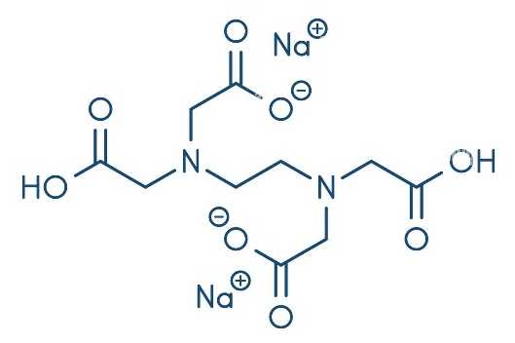
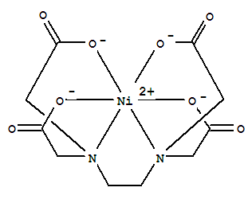
4. Complexometric Reactions
+
Ni⁺²
pH~10
Ni-Murexide complex
(Yellow)
(given solution)
Ni⁺²
Murexide (violet)
H₂O
OH₂
H₂O
Ni-Murexide complex (Yellow)
+
+
Murexide (violet)
Disodium EDTA
(Na₂H₂Y)
Ni-EDTA complex

Slide 6
Requirements
Chemicals Required
Standard -> ZnO as primary standard
Complexone -> Disodium EDTA
Buffer -> NH₄Cl + NH₄OH solution (ammonical buffer)
Indicators -> EBT and Murexide
Apparatus Required
Conical flasks and beakers
Volumetric flask and measuring cylinder
Test tubes
Pipette
Burette
Burette stand and white tile
5

Slide 7
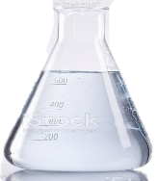

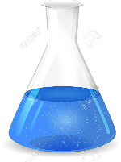
Procedure
1. Preparation of standard ZnO solution (100 mL)
Calculated amount of ZnO (s) + Few drops of HCl (to completely dissolve ZnO in water) + Distilled water (up to 100 mL mark) --> Mixture was shaken well to get homogenous solution
ZnO (s) + 2HCl (aq) ZnCl₂ (aq) + H₂O (l)
2. Standardization of EDTA solution
EBT (blue, 2-3 drops)
(pH~10)
EDTA (from burette)
ZnO (10 mL standard solution) + NH₄OH-NH4Cl (5 mL buffer solution)
Zn-EBT complex
(wine red)
Zn-EDTA complex +
EBT (blue)
6

Slide 8
3. Estimation of Ni⁺²
Indicator -> 0.1 g murexide + 10 g KNO₃, grind well and use 50 mg of mixture in each titration
Pipette 25 mL of given Ni⁺² solution in a conical flask and dilute to 100 mL (with deionised water)
Add 10 mL of 1 M NH₄Cl + conc NH₄OH buffer followed by 50 mg of indicator mixture
If solution turns orange, add more conc NH₄OH until solution turns clear yellow (pH~10)
Titrate against standard EDTA solution dropwise, until colour of solution changes from yellow -> violet at the end point (If at any intermediate stage, solution becomes orange, conc NH₄OH must be added to make it clear yellow)
Ni⁺² complexes slowly with EDTA, hence it must be added dropwise near the end point
10 mL of 1 M NH₄Cl + conc NH₄OH (pH~10)
Standard EDTA
(from burette)
Murexide (50mg)
25 mL Ni⁺² solution (diluted to 100mL)
Ni-Murexide complex
(yellow)
Ni-EDTA complex +
Murexide (violet)
7

Slide 9
Calculations
Let normality of standard ZnO solution prepared be N_{ZnO}, then
Normality of given EDTA solution
N_{EDTA} × V_{EDTA} = N_{ZnO} × V_{ZnO} (V_{ZnO} = 10 mL)
N_{EDTA} = N_{ZnO} × (10 / V_{EDTA}) (V_{EDTA} obtained form step 2)
Normality of Ni⁺² in given solution
N_{Ni+2} × V_{Ni+2} = N_{EDTA} × V_{EDTA} (V_{Ni+2} = 25 mL)
N_{Ni+2} = N_{EDTA} × (V_{EDTA} / 25) (V_{EDTA} obtained form step 3)
pH~9
Zn-EBT (wine red) + EDTA Zn-EDTA + EBT (blue)
pH~10
Ni-Murexide (yellow) + EDTA Ni-EDTA + Murexide (violet)
8

Slide 10
Gravimetry
It’s a form of quantitative analysis by weight, and involves isolation and weighing of specie being determined (or compound of that specie)
Principle -> If an element or radical under estimation forms a pure and stable compound with definite composition that can be readily isolated and weighed, then the amount of that element or radical in the test sample can be calculated just by relative atomic masses of constituent elements
Isolation Methods
Precipitation
Volatilisation (or Evolution)
Electroanalytical
Extraction and Chromatography
Only significant disadvantage of this analysis technique is it’s time consuming nature, which limits it’s use in many places
9

Slide 11
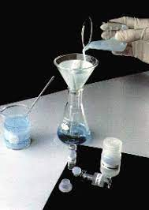
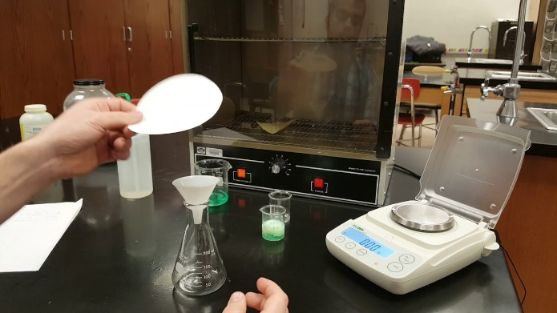
Scope
Advantages
Absolute method, involving only direct measurements without any form of calibration
Highly accurate and precise, with modern weighing balances
Regular checking of possible error sources
Filtrate -> can be checked for completeness of precipitation
Precipitate -> can be checked for impurities
Mostly uses inexpensive apparatus (the most costly being muffle furnace and platinum crucible in rare cases)
Applications
Analysis of standards for testing and calibration of instrumental techniques
Analysis which require high accuracy
Estimation of chemical composition, purity and thermal stability of compounds
10

Slide 12
Precipitation
It is the most widely used isolation method in gravimetric analysis. The element (or radical) under analysis is transformed into a insoluble precipitate, which can then be isolated
IDEAL PRECIPITATE
It should be readily convertible to a pure compound with definite chemical composition, via simple chemical processes like
Ignition
evaporation with a suitable liquid, etc
It should be highly insoluble, which on practical grounds means that
Very low K_{sp} ( << Ionic Product)
Amount of it left in solution should be less than least count of weighing balance used
Physical nature should be such that it can be
Readily separable by filtration (large particle size)
Washed free off soluble impurities (particle size unaffected or at least not diminished by washing)
11

Slide 13
Precipitate Contamination
It’s not necessary that precipitate that separates out of solution is always pure. Type and degree of contamination depends upon it’s nature and condition of precipitation
CO-PRECIPITATION
Contamination of ppt by substances which are normally soluble in mother liquor (co -> together)
Surface Adsorption
Adsorption of contaminants over surface of ppt particles exposed to solution
Greatest for gelatinous (large surface area) ppt, minimum for macro-crystalline (large particle size) ppt
Internal Contamination
Mostly occurs during fast building of precipitate from primary particles (coalescence)
Occlusion -> physical entrapment of contaminants adsorbed over primary particles (during fast coalescence) within ppt
Inclusion -> same as occlusion, but contaminants now occupies lattice sites within the ppt
POST-PRECIPITATION
Precipitation that occurs over the surface of main precipitate after (or post) it’s formation
Increases with time main ppt is left in contact with mother liquor
Ex Mg(C₂O₄) post precipitates over Ca(C₂O₄) ppt
12

Slide 14
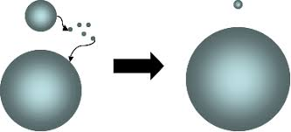
Digestion
Digestion is carried out by allowing ppt to stand for 12-24 hours or warming ppt for some time in contact with mother liquor
PURPOSE
reduce contamination
increase particle size and complete precipitation
EFFECT
Small particles
have high solubility and tend to pass in solution and re-deposit over larger particles
Co-precipitation over minute particles is hence eliminated
Rapidly formed crystals
have irregular shape and high surface area, which on digestion becomes regular and dense
Result is decrease in surface area and adsorption
RESULT
Decrease in overall co-precipitation
Increase in particle size and ease of filtration
13

Slide 15
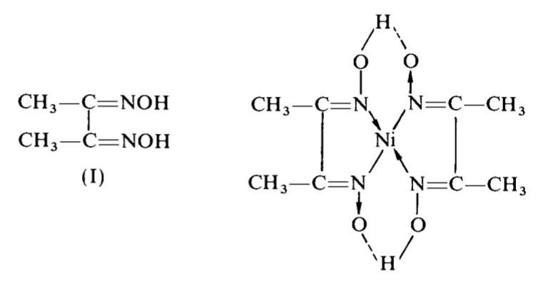
DMG
Dimethylglyoxime {H₃C · C(:NOH) · C(:NOH) · CH₃} was discovered by L.Tschugaeff, and applied by O.Brunck in estimation of Ni⁺² in steel
Has 2 ionisable H -> H₂DMG
Very slightly soluble in water (0.40g/L) -> used as 1% solution in 90% ethanol (rectified spirit) or absolute ethanol
Can be used as disodium salt (Na₂C₄H₆O₂N₂.8H₂O), which is soluble in water
Bidentate ligand, and forms a bright red [Ni(HDMG)₂] complex with Ni⁺²
Large excess of DMG should be avoided because
It can itself precipitate due to low solubility in water
[Ni(HDMG)₂] ppt can dissolve in high ethanol content (over 50%)
Interference from Fe⁺³, Al⁺³, Cr⁺³ and Bi⁺² is prevented by adding soluble tartrate or citrate, with which they form soluble complexes
DMG
Ni⁺² + 2H₂DMG [Ni(HDMG)₂] (bright red) + 2H⁺
[Ni(HDMG)₂]
14

Slide 16

Ni⁺²
+
2
Dil NH4OH
(or CH₃COONH₄ + CH₃COOH buffer)
+
2H⁺
Hot, faintly acidic solution
H₂DMG
[Ni(HDMG)₂] (bright red)
Ni⁺² solution is made faintly acidic (by dil HCl), to prevent it’s hydrolysis (as Ni(OH)₂ is very insoluble, Ksp~5.85E-16) and heated (70-80°C) to increase complexation rate
[Ni(HDMG)₂] ppt Is soluble in
Free mineral acid (even as low as produces by reaction)
Solutions having > 50% ethanol (by volume)
In concentrated ammonia
Therefore…
Large excess of DMG containing ethanol is avoided
slight excess of dil NH4OH or (CH₃COONH₄ + CH₃COOH) buffer is added to neutralise free mineral acids
CH₃COONa in place of CH₃COONH₄ should be used in presence of Mn, Co and Zn
15. Precipitation Reaction

Slide 17
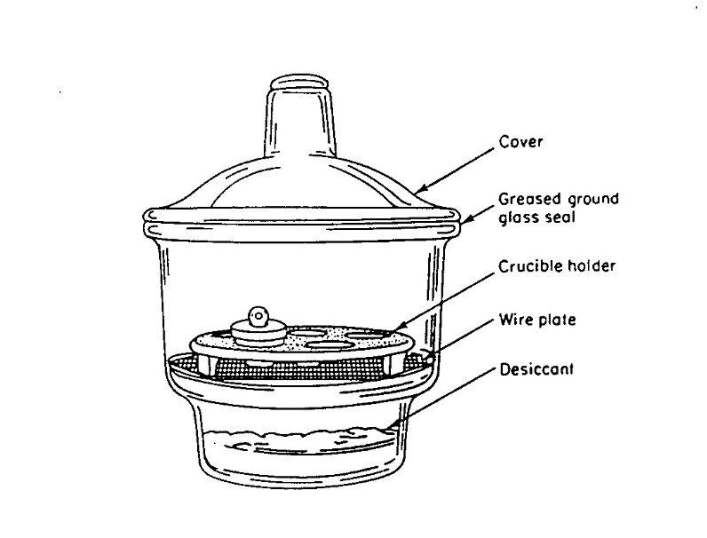
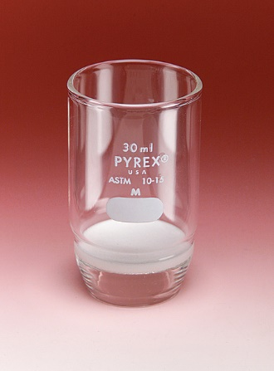
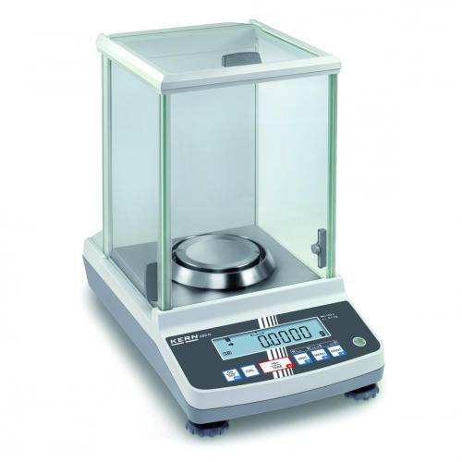
Requirements
Chemicals Required
Ni⁺² solution
Dilute HCl solution (1:1)
DMG reagent (1% solution in 90% or absolute ethanol)
Dilute NH₄OH solution
Apparatus Required
Crucible
Desiccator (sealable container with desiccants which absorb moisture from air, ex CaCl₂, CaSO₄. Used to sustain state of dryness)
Weighing balance
Beakers (100 and 500mL)
Test tubes
Measuring cylinder
Glass rod
DESICCATOR
CRUCIBLE
BALANCE
16

Slide 18
Procedure
Preparation of NI⁺² solution (200 mL)
0.3-0.4g (NH₄)₂SO₄.NiSO₄.6H₂O (Ammonium Nickel Sulphate) in 500 mL beaker + 5 mL dil HCl (1:1, to prevent hydrolysis) + dilute to 200 mL with distilled water
Precipitation of [Ni(HDMG)₂]
Heat Ni⁺² solution to 70-80°C, and add slight excess of DMG reagent (at least 5 mL for every 10 mg Ni⁺²)
Immediately add dil NH₄OH solution dropwise (directly to solution rather down the sides of beaker) with continuous stirring until precipitation occurs, and finally in slight excess
Allow to stand on steam bath for 20-30 minutes, and then check for complete precipitation
Allow ppt to stand for an hour, cooling at the same time
Filter cold solution through a porcelain filtering crucible (preheated to 110-120°C)
Cool the Nickel Dimethylglyoximate (bright red) precipitate in desiccator
17

Slide 19
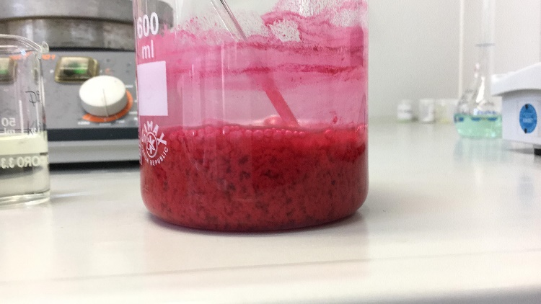
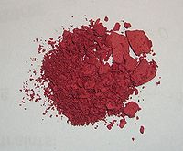
Drying and Weighing
Wash [Ni(HDMG)₂] ppt with cold water (until free from soluble salts like chlorides)
Dry at 110-120°C (or 150°C for high accuracy ) for 45-50 minutes. This volatises any reagent that may have carried down with ppt
Cool in desiccator (moisture free environment) and weigh
Repeat the drying until constant weight is achieved
WET
DRIED
[Ni(HDMG)₂] PPT
18

Slide 20
Calculations
% of Ni in [Ni(HDMG)₂]
Molecular Formula -> Ni(C₄H₇O₂N₂)₂
Relative atomic masses of constituents (u) -> Ni = 58.69, C = 12, H = 1, O = 16, N = 14
Total Molecular Mass (u) -> 288.69
% of Ni -> (58.69u / 288.69u) * 100 = 20.32%
Mass of Ni⁺² in test sample (M_{Ni+2})
Let mass of [Ni(HDMG)₂] measured experimentally (constant value) -> M_{Ni-DMG}
Then, M_{Ni+2} = Mass of Ni⁺² in [Ni(HDMG)₂]
M_{Ni+2} = (% of Ni in complex / 100) * M_{Ni-DMG}
M_{Ni+2} = (20.32 / 100) * M_{Ni-DMG}
M_{Ni+2} = 0.2032 * M_{Ni-DMG}
19

Slide 21
Comparison
Complexometry | Gravimetry
Reasonably accurate (depends upon stability of M-In and M-EDTA complex) | Highly accurate (depends upon nature of specie being isolated)
Quick estimation | Consumes lot of time
Relative method (involves titration against standards) | Absolute method (no calibration required)
Highly error prone (pH sensitivity, low stability of complexes, indicator error etc) | Error sources (filtrate and precipitate) can be easily checked
Can produce a lot of waste | Waste is mostly limited to reagents and isolated compound
Used to estimate relative proportions of metal ions in the solution | Used in high accuracy demanding areas, like analysis of standards
20

Slide 22
References
Vogel’s textbook of quantitative chemical analysis
https://en.wikipedia.org
https://chemistry.stackexchange.com
https://www.chemeurope.com/en/encyclopedia
21

